Slide 1
Parents’ evening
presentation
Security marking: PUBLIC

Slide 2
UCAS
An independent charity
UCAS does:
process applications
provide information, advice, and training
have a Fraud and Verification Team
take part in education sector engagement
UCAS doesn’t:
suggest courses or universities
make decisions or offers
advise on finance, immigration, or visas for individuals

Slide 3
Course providers
370+ universities and colleges
  five in Northern Ireland
  20 in Wales
  21 in Scotland
  334 in England
  one in mainland Europe
37,000+ courses available

Slide 4
Choices available
Higher education.
Apprenticeships and traineeships.
Studying abroad.
Gap year.
Getting a job.
Understand the options available at
www.ucas.com/alternatives-to-university

Slide 5
Apprenticeship advice
UCAS has apprenticeships advice to help students make informed decisions about their post-16 and post-18 opportunities.
Find out about:
  the different types of apprenticeships
  how to find and apply for apprenticeships
  preparing for the application and interview process
With the predicted growth of higher and degree apprenticeships, you’ll also find a dedicated degree and professional apprenticeships section on ucas.com, which profiles current programmes in more detail.

Slide 6
Why higher education?
Opportunities while studying:
Chance to study a subject they are passionate about.
Achieve a qualification that could lead to their chosen career.
Grow in confidence, make lifelong friends, and gain independence and important life skills that will widen their prospects.
With a degree, they’ll have:
  the opportunity to follow their career path
  better job prospects, as many employers target graduates
  higher earning potential

Slide 7
Choosing the right university
Style – from traditional, with a focus on subject-based courses and research, to more modern universities that may have a greater focus on vocational courses.
Location – some are based in large cities, others in smaller towns. This can have a major influence on the environment and lifestyle on offer.
Size – larger universities can have more than 20,000 students, whereas some of the smallest have only a few thousand.
Culture and facilities – influenced by a range of factors, including the diversity of students who attend.
What graduates do – all universities collect destination statistics. It can be interesting to find out the types of jobs or further study students go on to.
Tuition fees – can vary between course providers. Check if there are any scholarships/bursaries available.
Living costs – accommodation, transport, and food can vary enormously.
Notes:
Which modules are the most interesting and relevant to applicants career aspirations?
How many lectures are there and how much group work will be done in seminars?
What combination of exams, coursework or presentations is the course assessed by?
Who are the tutors and are they experts in areas the applicant wants to learn about?
What subject areas do they specialise in?
Can applicants study abroad or get help with work placements?
Do they have sports facilities or societies to join?
How near home, a city center or the countryside are they?

Slide 8
Choosing the right course
What does the course cover?
Courses with the same title may be very different.
Look carefully at the core course content, and the range of optional studies/modules available.
Which modules are the most interesting and relevant to career aspirations?
See if the course or university/college offers any internship, placement, or study abroad opportunities.
How is the course taught – structured teaching, or more independent research? How many lectures are there, and how much group work will be done in seminars?
How is the course assessed?

Slide 9
Research – it’s free!
Search tool – to look for providers, courses, and minimum entry requirements. Use the subject guides to find more information.
Open days and virtual tours – a great way to explore campuses and facilities.
UCAS’ higher education exhibitions – useful to meet different universities and colleges, and explore options. It is important to register, and encourage your students to register in advance.
Learning from others – student videos and blogs.
Career options – use the job profiles to explore different career roles and pathways, or take the Buzz quiz to find out more about individual strengths, and what roles they may suit.
The career finder tool is ideal for considering options after education, including searching for apprenticeships.

Slide 10
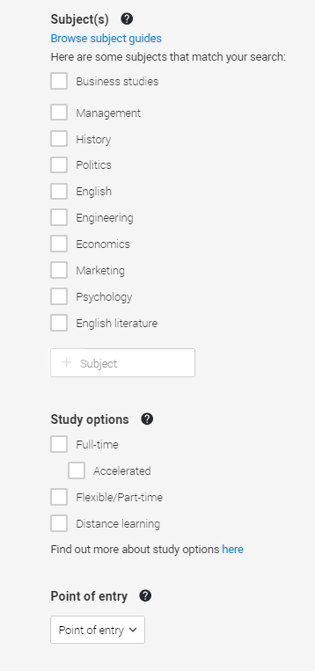

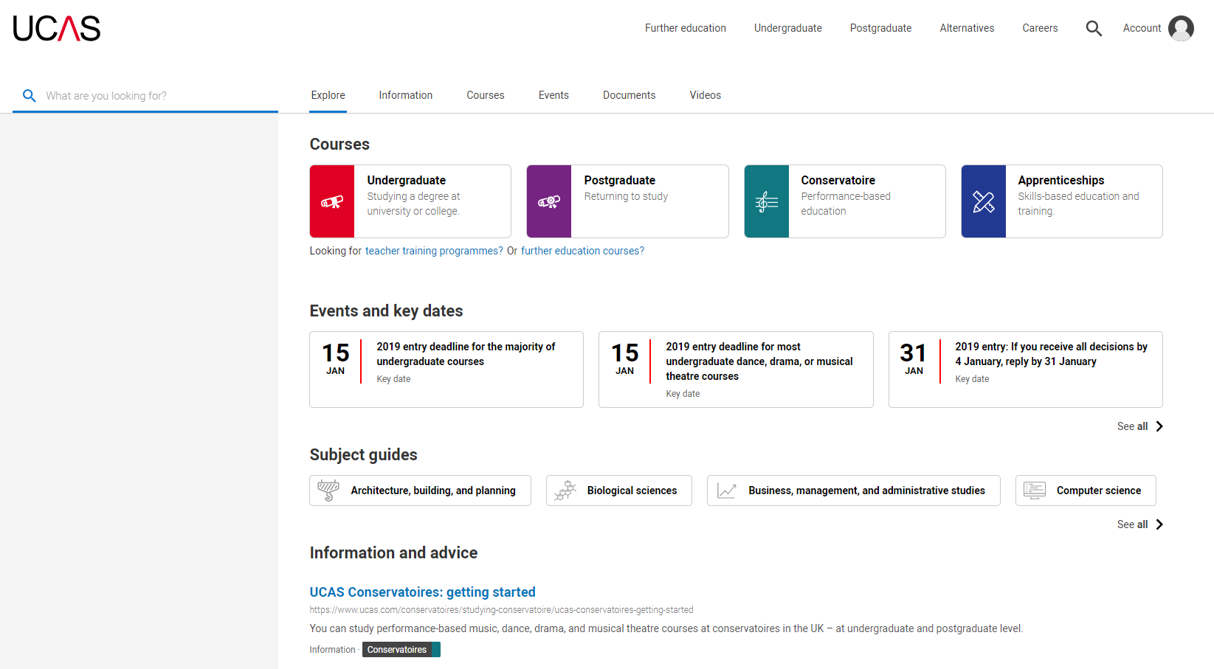
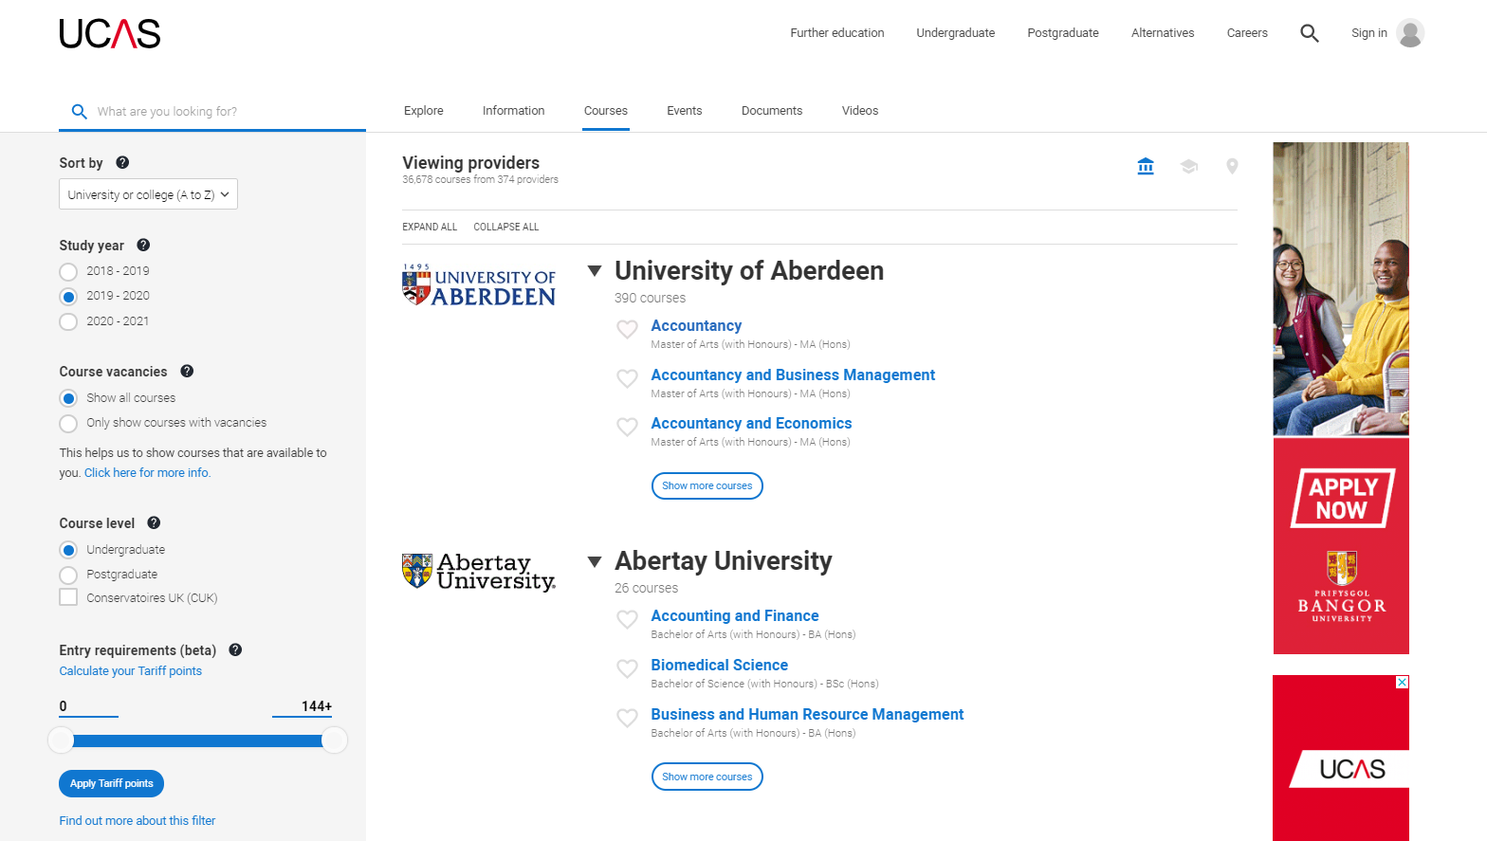
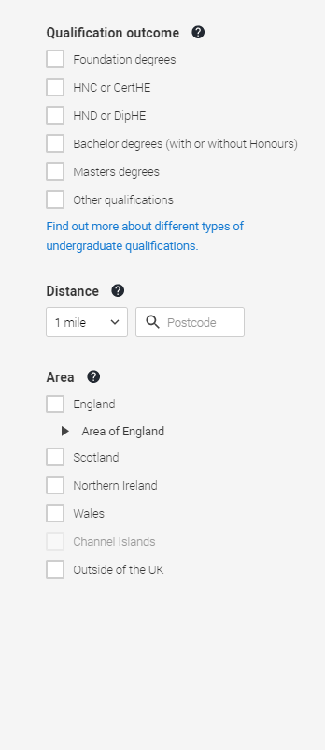

Slide 11
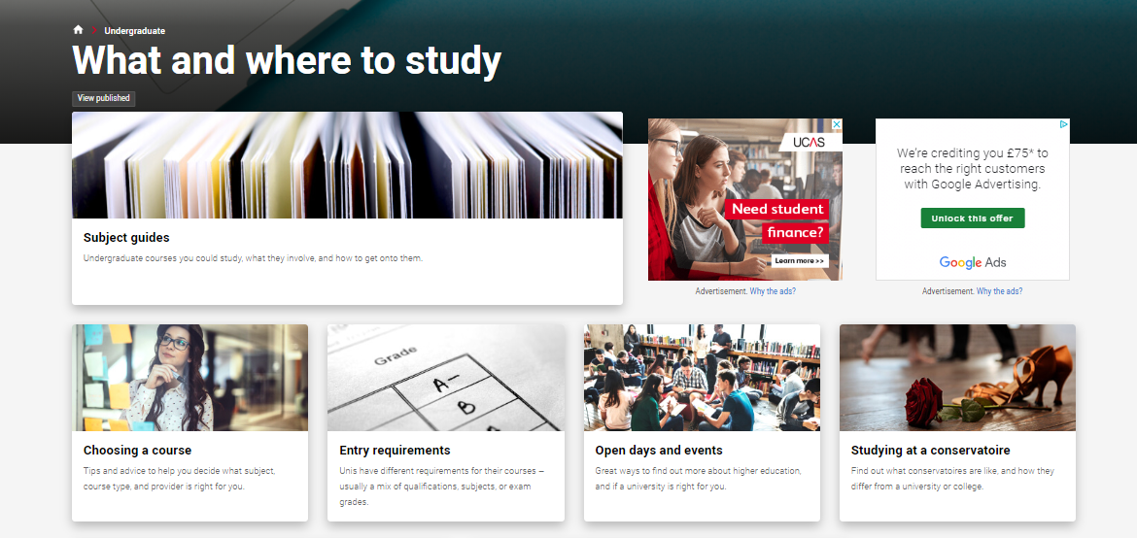

Slide 12
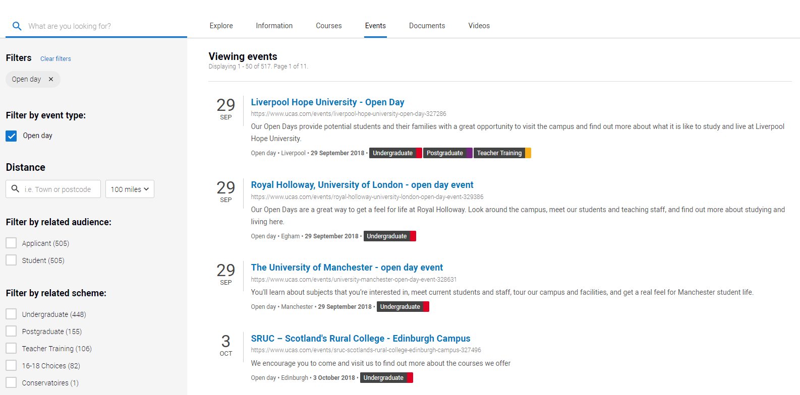
Open day search

Slide 13
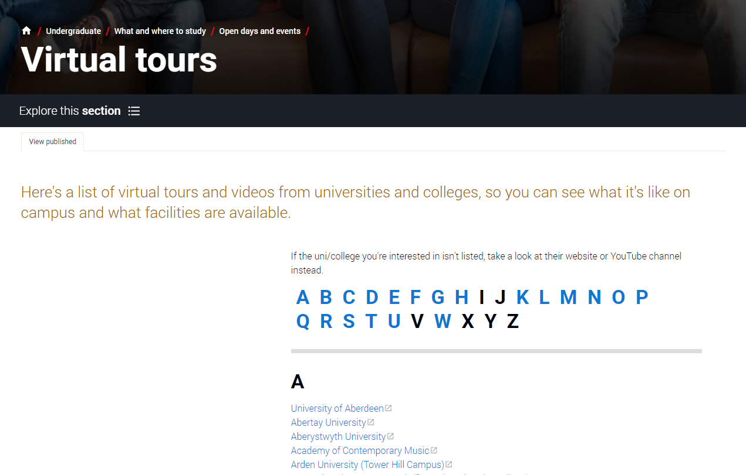
Virtual tour search

Slide 14
Apply key facts
Application is entirely online.
Maximum of five choices.
Some choice restrictions:
  medicine, veterinary medicine/science, dentistry
  (maximum of four)
  Oxford or Cambridge
Simple application cost:
  one choice – £20 (changed for 2020 cycle)
  two to five choices – £25
Equal consideration.
‘Invisibility’.

Slide 15
When to apply for 2020 entry
21 May UCAS Undergraduate Apply opens for 2020 entry.
4 September First day for receipt of completed applications.
15 October* Application deadline for courses in medicine, veterinary medicine/science, and dentistry, and courses at Oxford or Cambridge.
15 January* Equal consideration application deadline.
25 February Extra opens.
30 June* Last date for applications before Clearing.
* All 18:00 (UK time)

Slide 16
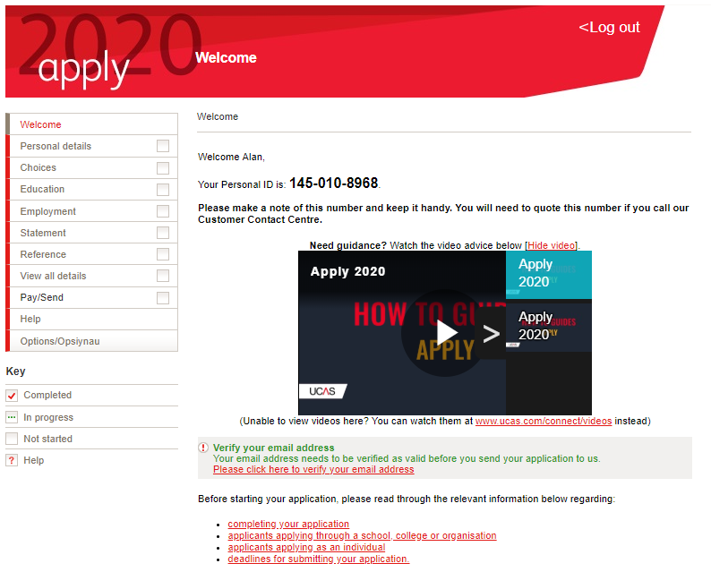
Completing the UCAS application
Sections to complete:
Personal details
Additional information
Student finance
Choices
Education
Employment
Personal statement
Referee details
Tutor adds reference
UCAS
Universities/colleges

Slide 17
The personal statement
The only section the applicant has full control over.
Their only chance to market themselves individually.
One personal statement for all choices.
  Maximum of 4,000 characters, or 47 lines.
  Minimum of 1,000 characters.
  No spelling/grammar check.
  No formatting.

Slide 18



Decisions
Universities and colleges will review the:
They may also ask for:
And make one of three decisions:
personal statement
    Unconditional offer
Admissions test
qualifications
Interview
    Conditional offer
reference
    Unsuccessful
Portfolio/audition

Slide 19


Tracking applications
Track allows applicants to:
follow the progress of their application 24/7
see their choices and personal information
view their offers
reply to offers online
In Track, a student can hold up to two offers:
  firm – their first choice. If they meet the conditions of the offer they will be placed here
  insurance – acts as a back-up choice if they are not placed with their firm choice
Notes:
If an applicant does not receive offers at the same time as their friends – this is normal. Each institution makes offers in different ways and at different rates.
Applicants do not have to have an insurance choice if they are certain they would only be interested in one of their offers.
Applicants cannot swap between their insurance and firm choices.
The insurance choice disappears once they have been placed with their firm choice.

Slide 20
Other options
Extra (25 Feb – 5 Jul)
  Used all five choices and had no offers (or declined all offers/withdrew).
  Add Extra choices for consideration one at a time via Track.
Clearing (6 Jul – Oct)
Apply after 30 June, receive no offers, decline all offers, or not met conditions.
Find vacancies from 6 July, and add one choice via Track.
Adjustment (up to five days in Aug)
Placed with firm choice, and did better than conditional offer.
Register in Track, then find another university or college. The new university or college adjusts the record.

Slide 21
What should your child be doing now?
Research.
Extracurricular activities.
Work experience.
Go beyond the syllabus.
Focus on this year’s studies.

Slide 22
How can you support them?
    Use the parents/guardians’ section of the UCAS website at www.ucas.com/parents.
    Sign up for updates from UCAS, and get everything you need to know about the application process direct to your inbox.
    Offer to attend open days – you may have a different perspective.
    Don’t book family holidays at key times.
    Make sure they read everything carefully that is sent to them.

Slide 23
Thank you

